Slide 1
CITY

Slide 3
WIN
SPR
SUM
AUT
WIN

Slide 5
WIN
SPR
SUM
AUT
WIN

Slide 6
SUN
MON
TUE
WED
THU
FRI
SAT
SUN
MON
TUE
WED
THU
FRI
SAT

Slide 7
LOCAL/REGIONAL

Slide 8
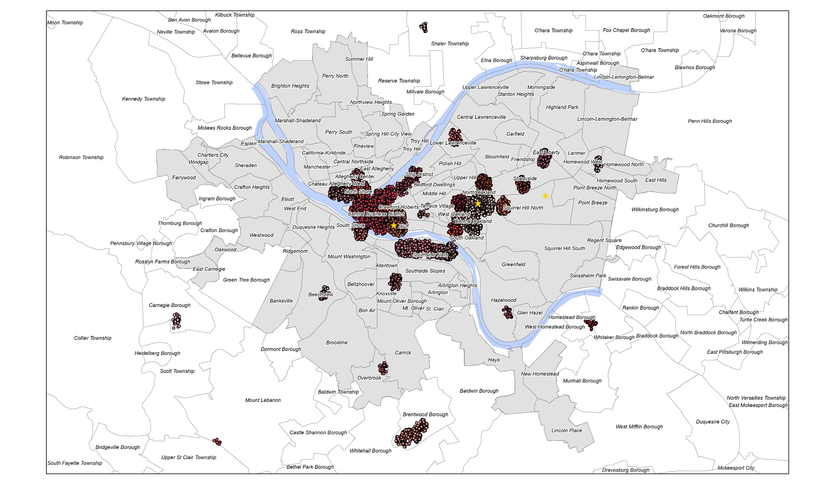

Slide 11
WIN
SPR
SUM
AUT
WIN
WIN
SPR
SUM
AUT
WIN

Slide 12
WIN
SPR
SUM
AUT
WIN
WIN
SPR
SUM
AUT
WIN

Slide 13
WIN
SPR
SUM
AUT
WIN
WIN
SPR
SUM
AUT
WIN

Slide 14
WIN
SPR
SUM
AUT
WIN

Slide 15
SUN
MON
TUE
WED
THU
FRI
SAT
SUN
MON
TUE
WED
THU
FRI
SAT

Slide 16
SUN
MON
TUE
WED
THU
FRI
SAT
SUN
MON
TUE
WED
THU
FRI
SAT

Slide 17
SUN
MON
TUE
WED
THU
FRI
SAT
SUN
MON
TUE
WED
THU
FRI
SAT

Slide 18
SUN
MON
TUE
WED
THU
FRI
SAT
SUN
MON
TUE
WED
THU
FRI
SAT

Slide 19
SUN
MON
TUE
WED
THU
FRI
SAT
SUN
MON
TUE
WED
THU
FRI
SAT

Slide 20
SUN
MON
TUE
WED
THU
FRI
SAT
SUN
MON
TUE
WED
THU
FRI
SAT

Slide 21
SUN
MON
TUE
WED
THU
FRI
SAT
SUN
MON
TUE
WED
THU
FRI
SAT

Slide 22
SUN
MON
TUE
WED
THU
FRI
SAT
SUN
MON
TUE
WED
THU
FRI
SAT

Slide 23
SUN
MON
TUE
WED
THU
FRI
SAT
SUN
MON
TUE
WED
THU
FRI
SAT

Slide 24
SUN
MON
TUE
WED
THU
FRI
SAT
SUN
MON
TUE
WED
THU
FRI
SAT

Slide 25
SUN
MON
TUE
WED
THU
FRI
SAT
SUN
MON
TUE
WED
THU
FRI
SAT

Slide 26
SUN
MON
TUE
WED
THU
FRI
SAT
SUN
MON
TUE
WED
THU
FRI
SAT

Slide 27
SUN
MON
TUE
WED
THU
FRI
SAT
SUN
MON
TUE
WED
THU
FRI
SAT

Slide 28
SUN
MON
TUE
WED
THU
FRI
SAT
SUN
MON
TUE
WED
THU
FRI
SAT

Slide 29
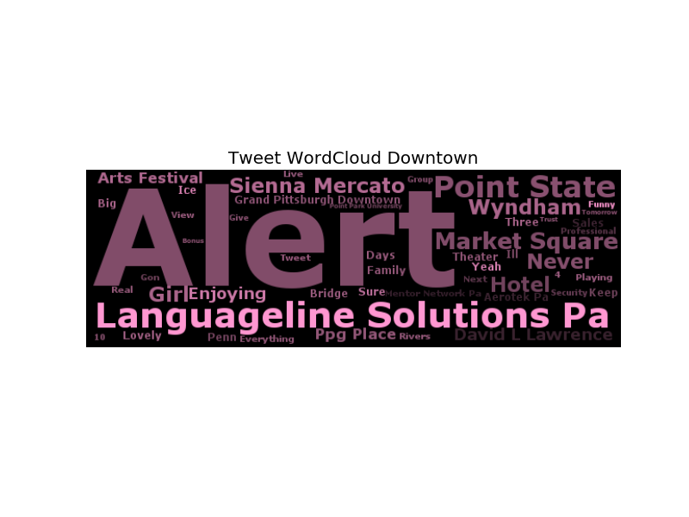

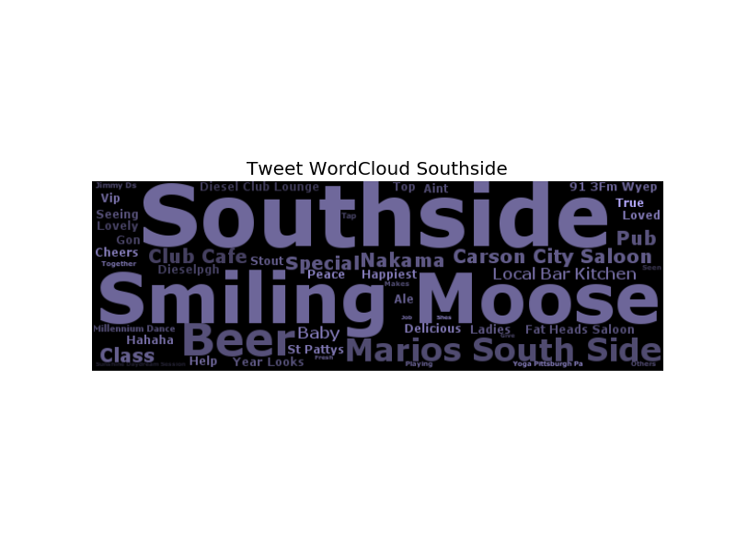
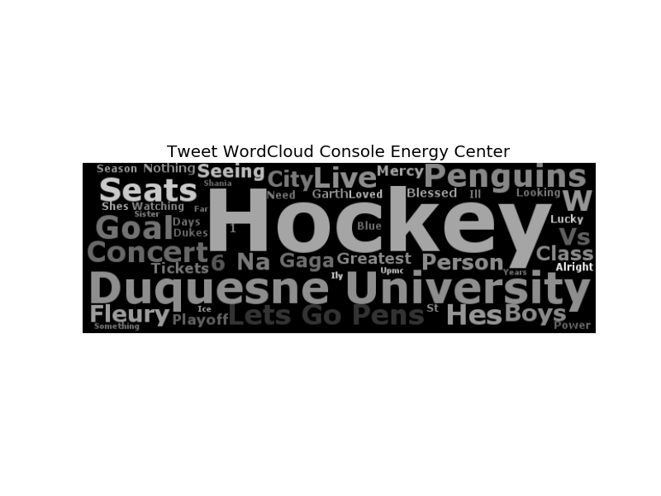

Slide 30
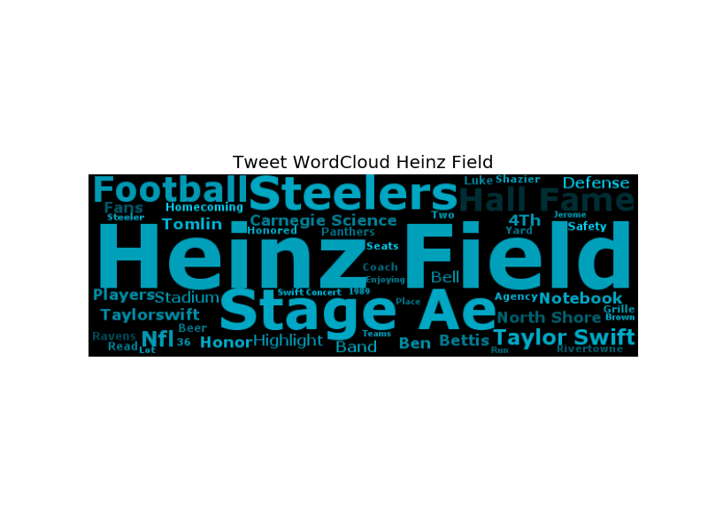
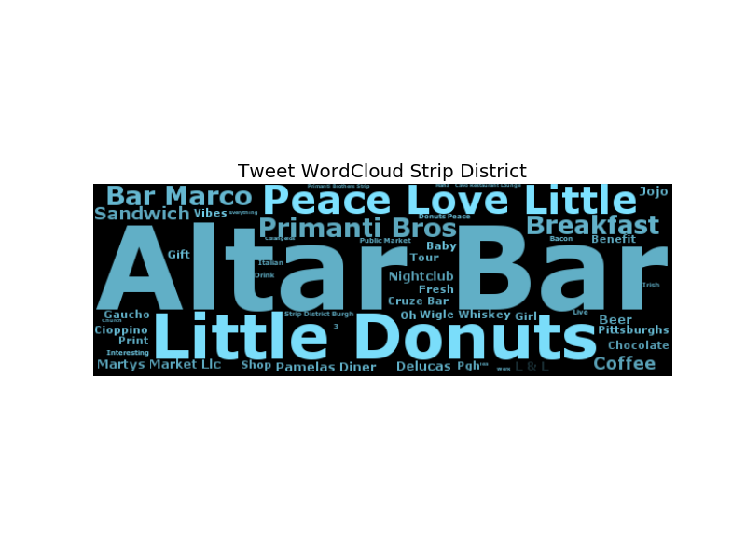



Slide 31
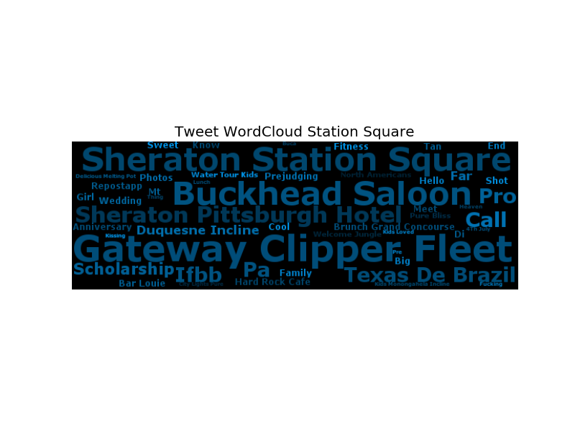

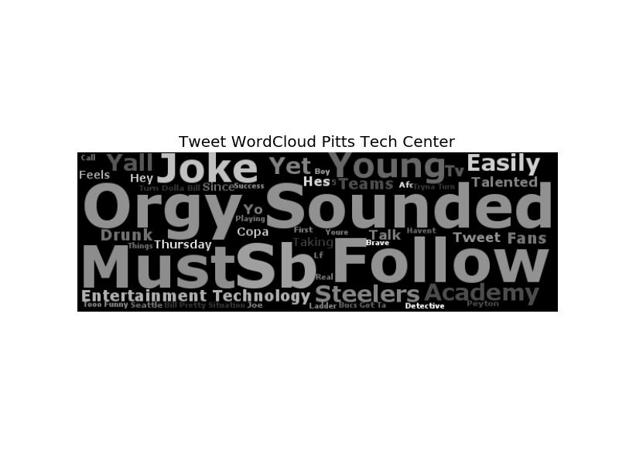
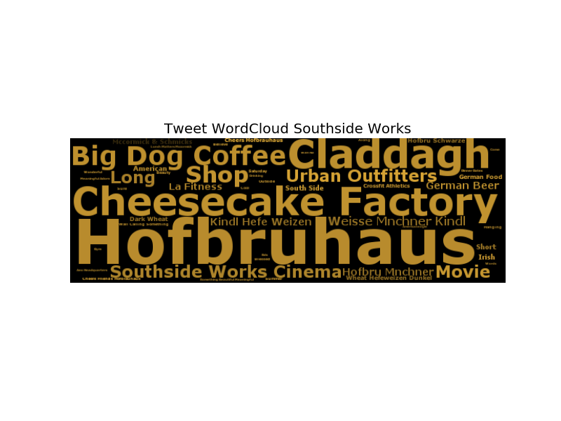

Slide 32

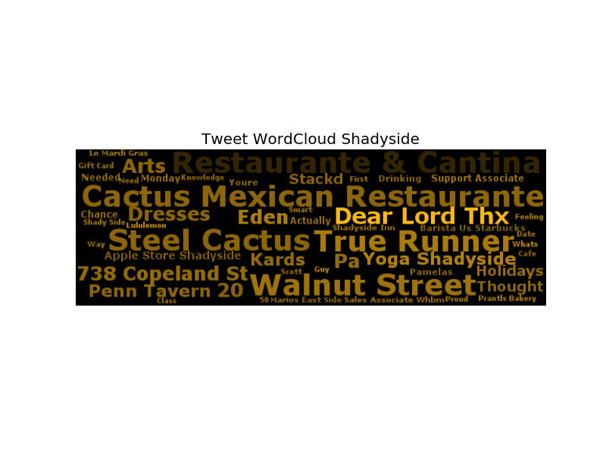

Slide 33
VENUES

Slide 34
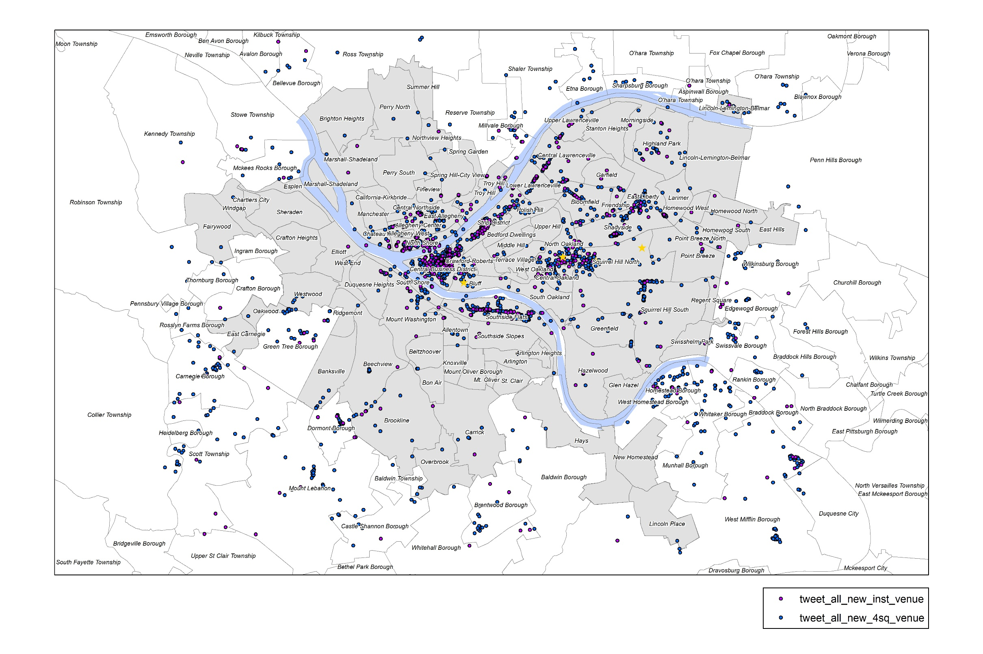

Slide 35
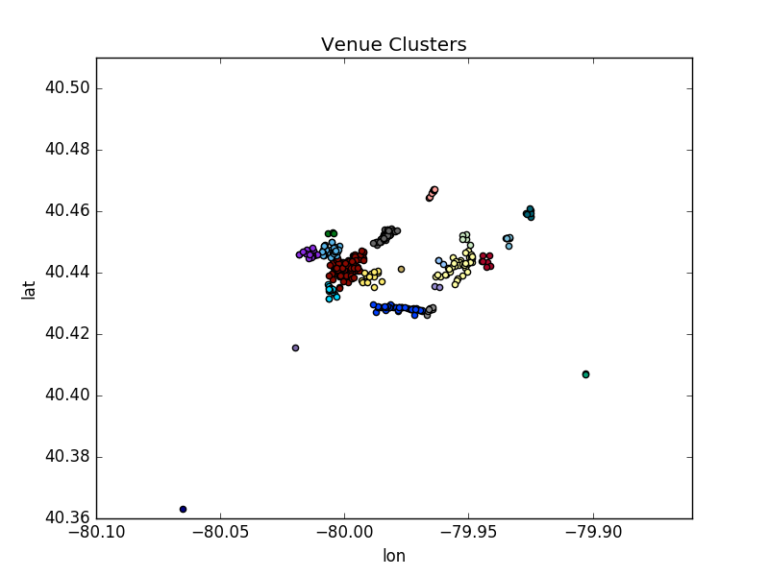
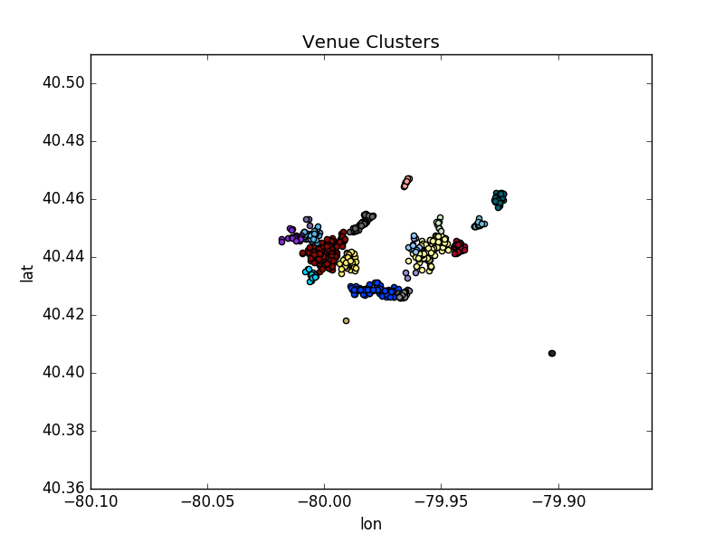
Replace by gis map

Slide 36
Venue# from Foursquare and Instagram auto-tweets
cluster |  | 4sq | inst | cluster |  | 4sq | inst
 | pittsburgh | 1100 | 405 | 12 | southside works | 26 | 10
0 | downtown | 378 | 116 | 13 | station square | 20 | 18
1 | oakland | 128 | 44 | 15 | east liberty | 54 | 9
2 | console energy center | 45 | 14 | 16 | lower lawrenceville | 15 | 8
3 | southside | 162 | 50 | 17 | carnegie borough | 1 | 0
4 | pnc park | 44 | 28 | 18 | shadyside | 45 | 9
5 | heinz field | 30 | 23 | 19 | beechview | 6 | 1
6 | strip district | 81 | 47 | 20 | upper st clair township-mount lebanon | 0 | 1
8 | oakland-west | 13 | 3 | 21 | terrace village | 0 | 2
9 | oakland-north | 10 | 5 | 22 | northside-national aviary | 6 | 4
10 | cmu | 34 | 9 | 23 | homestead | 2 | 2
11 | pitts tech center | 4 | 2 | 24 | allentown-knoxville-southside slopes | 2 | 0

Slide 37
Pearson correlation coefficients between happy tweet# and check-in#
cluster |  | inst-doy | inst-how | 4sq-doy | 4sq-how
 | pittsburgh | 0.15792 | 0.4827 | 0.18637 | 0.47387
0 | downtown | 0.06501 | 0.05144 | 0.02715 | 0.41823
1 | oakland | 0.03078 | 0.03438 | 0.10131 | 0.18163
2 | console energy center | 0.19122 | -0.07495 | 0.30607 | -0.13524
3 | southside | 0.04229 | 0.29022 | 0.02988 | 0.15624
4 | pnc park | 0.06547 | 0.04656 | -0.03646 | -0.15216
5 | heinz field | 0.10982 | 0.00708 | -0.11799 | -0.00577
6 | strip district | 0.06042 | 0.27053 | 0.04709 | 0.2636
10 | cmu | 0.02499 | -0.04087 | 0.08081 | 0.08733
11 | pitts tech center | -0.06256 | -0.04872 | -0.01799 | 0.00904
12 | southside works | -0.05515 | -0.01868 | -0.08637 | 0.27137
13 | station square | 0.07156 | 0.03219 | -0.04575 | 0.14051
15 | east liberty | -0.07019 | 0.06231 | -0.01377 | 0.13269
16 | lower lawrenceville | -0.04133 | -0.00286 | 0.00253 | 0.08068
18 | shadyside | -0.01823 | -0.09287 | -0.01641 | 0.23733

